Slide 1
Convolutional Neural Network-II
Slides from
http://wangshusen.github.io/teaching/CS583A20Spring/index.html
https://courses.d2l.ai/berkeley-stat-157/index.html

Slide 2
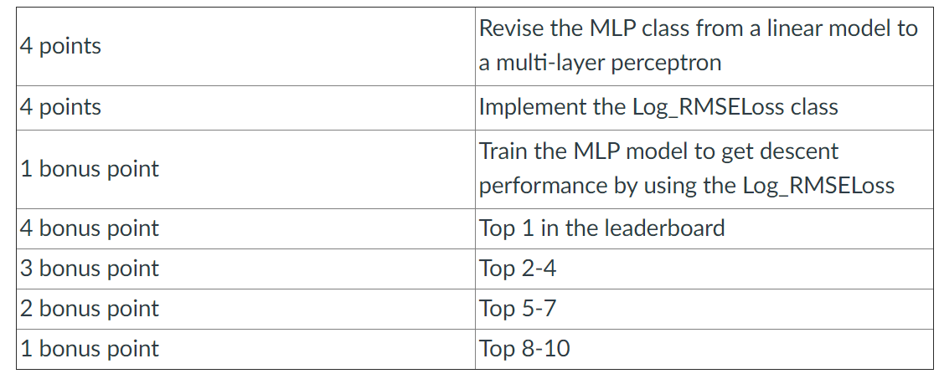
Announcements
The new deadline for Homework Three is Oct 27 (hard deadline)

Slide 3
Announcements
The deadline for Homework Four is Nov 3
Please use Google Colab if your computer do not have GPU
Leaderboard on Google Doc
Same bonus scores as Homework Three for students with top rankings
The deadline for choosing a Kaggle competition as your course project is today
Please submit your decision on google doc
Please also choose your preference date to give the poster presentation by Oct 25

Slide 4
Announcements
Syllabus update regarding grading
Homework (50%)
Six programming assignments
For Homework 6 and 7, you could select either one.
If you do both assignments, you will receive up to 7 bonus scores.
Course Project (30%)
Grading from peers (18pt) and the instructor (12pt)
More than 7 in 10 Gen-Zers report symptoms of depression during pandemic, survey finds

Slide 5






History of Neural Networks
Yann LeCunn used convolution to solve image problems; he used BP to learn the filters.
BP was invented by different researchers independently
AlexNet won the ImageNet Challenge
The first neural network
LeNet
1943
1958
1960’s
1986 1989 1997
1998
2012
Perceptron
Hinton and others reinvented BP; it then became popular.
LSTM was invented.
Neural networks were considered “dead” by most ML researchers.
RNN was invented.

Slide 6
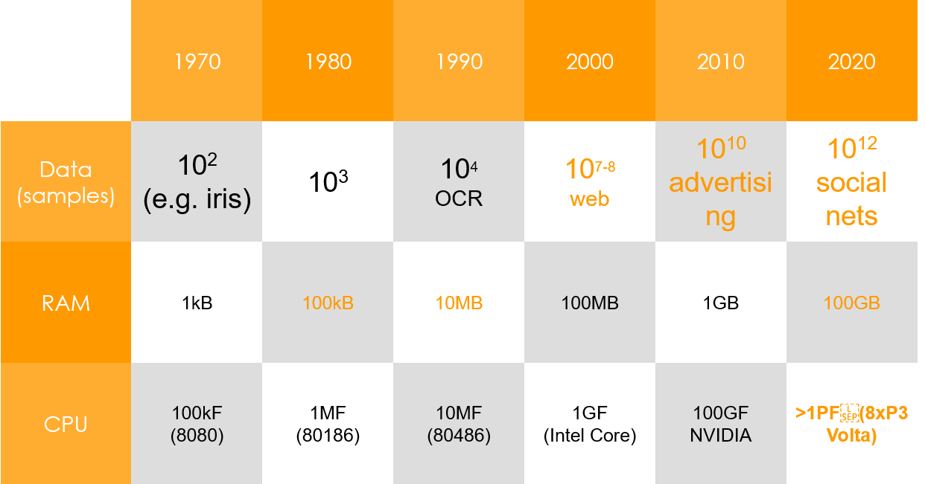
Hardware
Deep Net
Deep Net
Kernel Methods

Slide 7
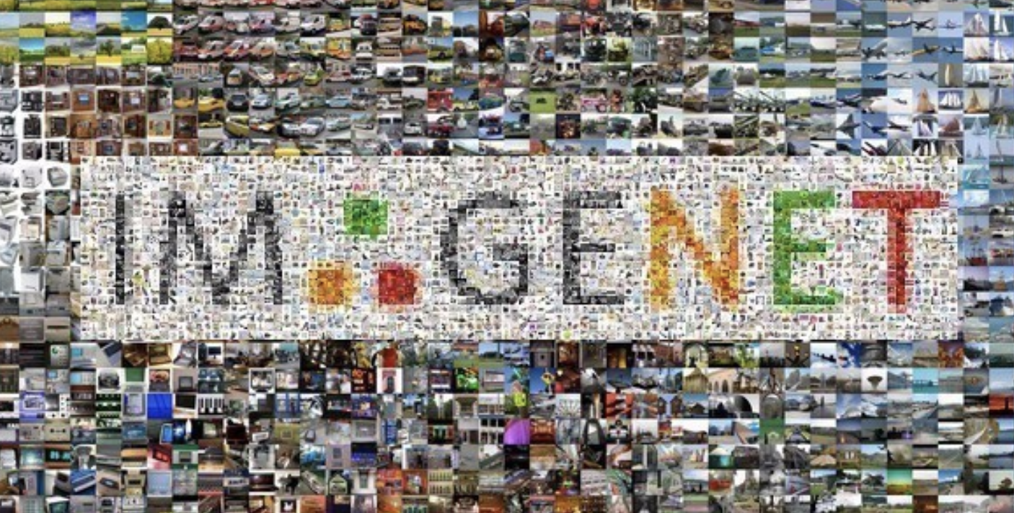
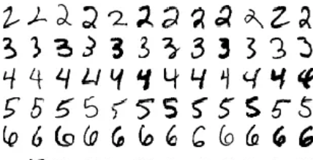
ImageNet (2010)
Images | Color images with nature objects | Gray image for hand-written digits
Size | 469 x 387 | 28 x 28
# examples | 1.2 M | 60 K
# classes | 1,000 | 10

Slide 8
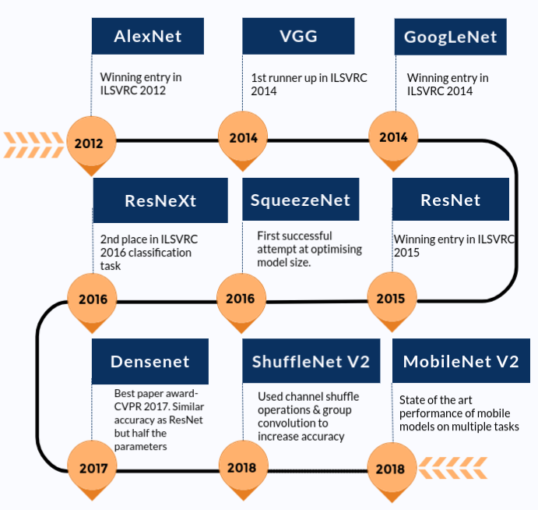

Slide 9
Demo

Slide 10


Slide 11
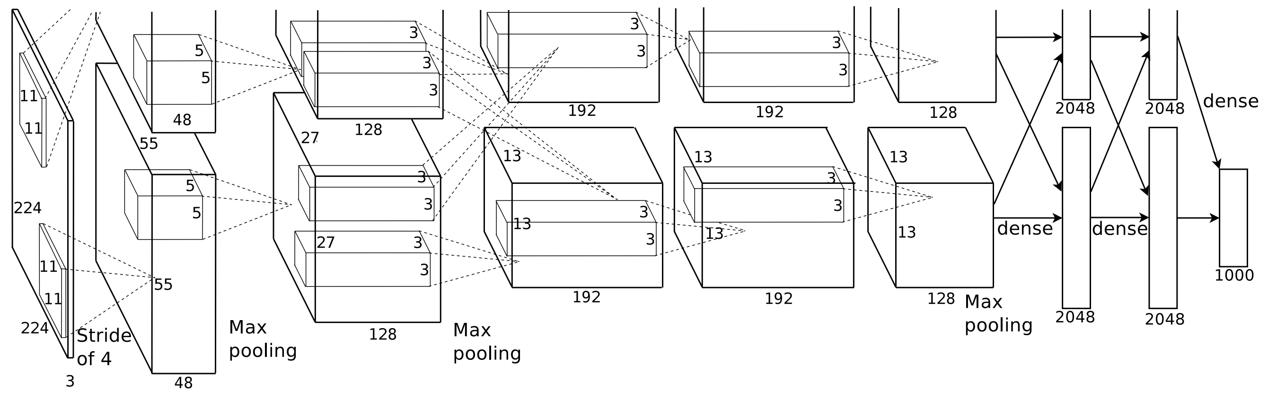
AlexNet
Krizhevsky, Alex, Ilya Sutskever, and Geoffrey E. Hinton. "Imagenet classification with deep convolutional neural networks." NIPS. 2012.

Slide 12
AlexNet
SVM
Softmax regression
AlexNet won ImageNet competition in 2012
Deeper and bigger LeNet
Key modifications
Dropout (regularization)
ReLu (training)
MaxPooling
Paradigm shift for computer vision
Manually engineered features
Features learned by a CNN

Slide 13
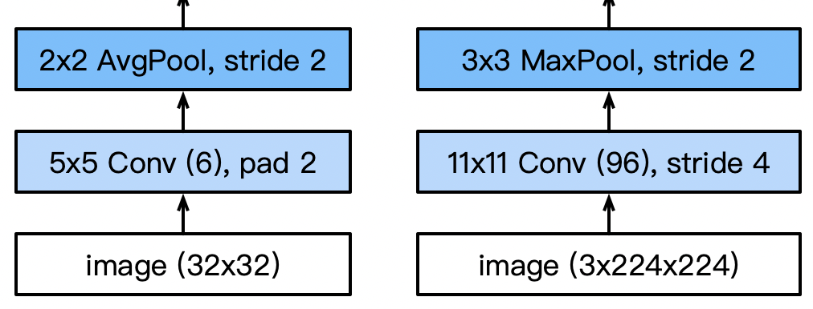
AlexNet Architecture
AlexNet
LeNet
Larger pool size, change to max pooling
Larger kernel size, stride because of the increased image size, and more output channels.

Slide 14
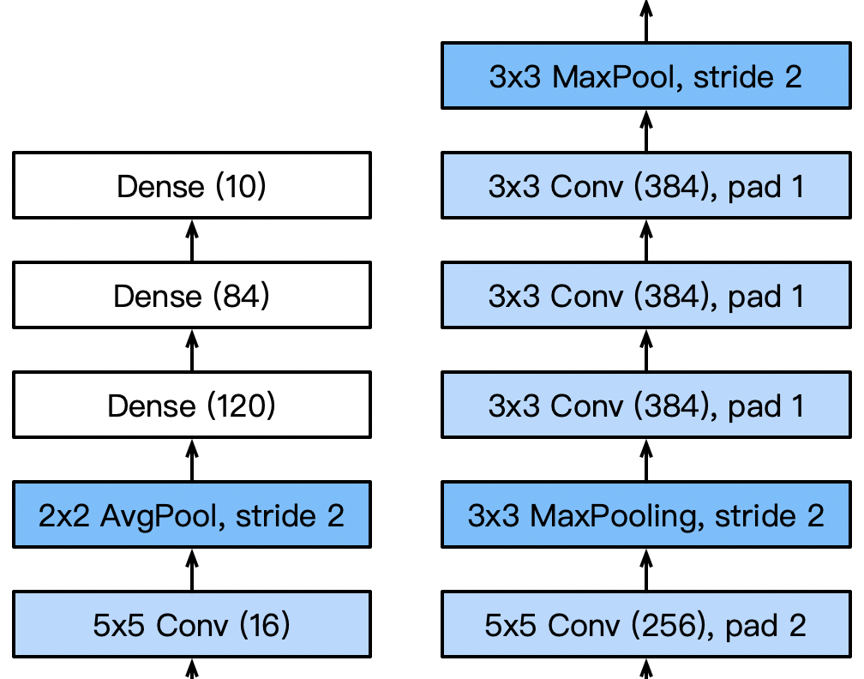
AlexNet Architecture
AlexNet
LeNet
3 additional convolutional layers
More output channels.

Slide 15
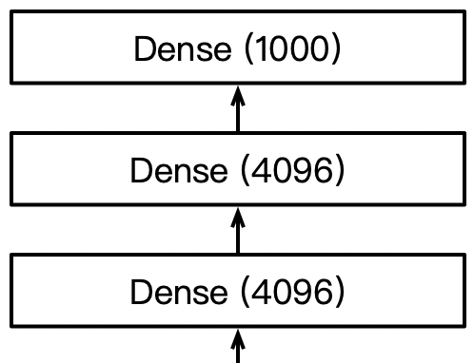
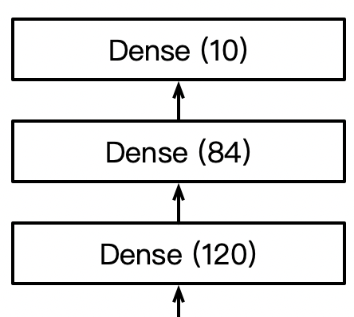
AlexNet Architecture
AlexNet
LeNet
1000 classes output
Increase hidden size from 120 to 4096

Slide 16
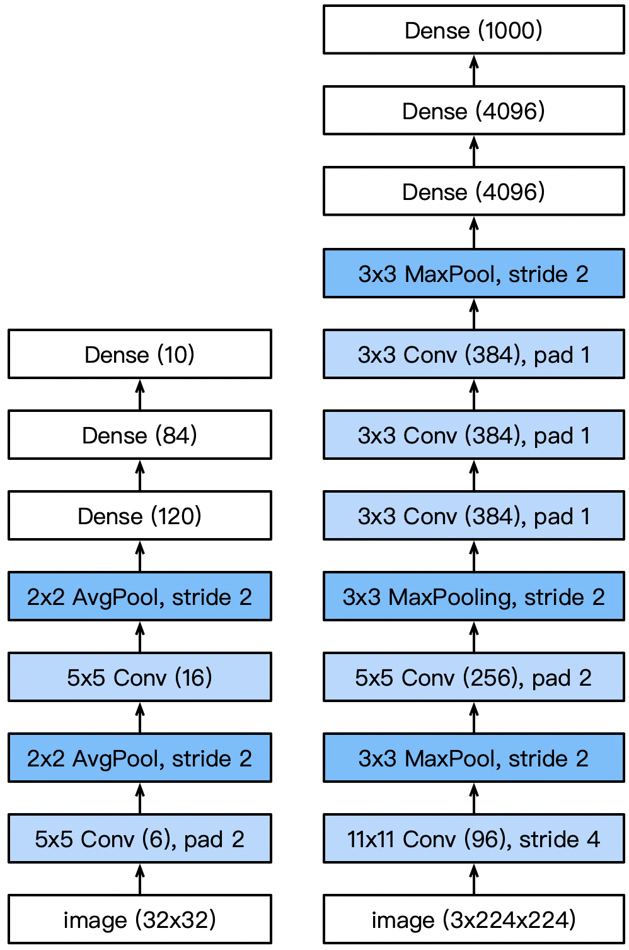
AlexNet Architecture

Slide 17
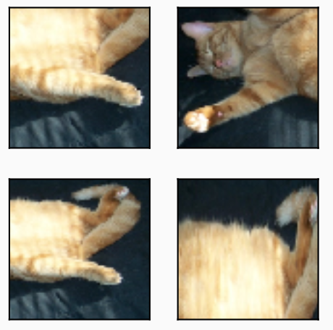
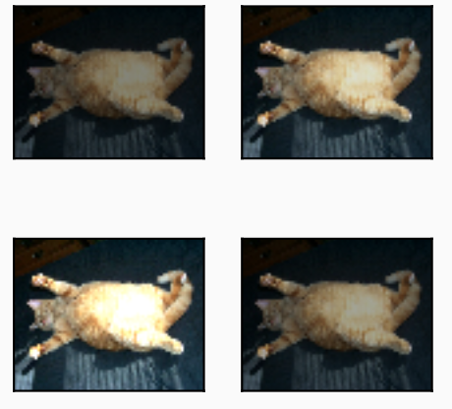
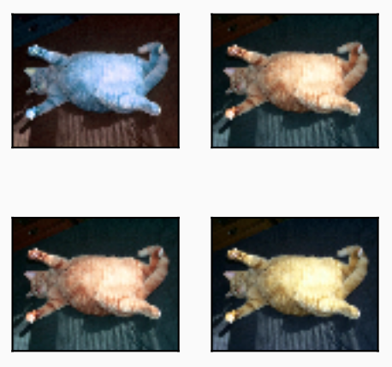
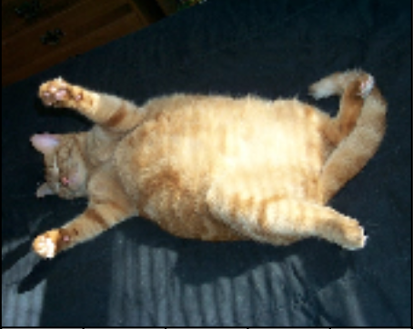
More Tricks
Change activation function from sigmoid to ReLu (no more vanishing gradient)
Add a dropout layer after two hidden dense layers (better robustness / regularization)
Data augmentation

Slide 18
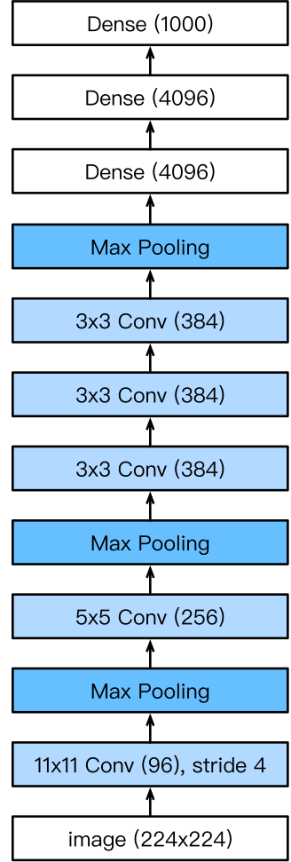
Complexity
 | #parameters |  | FLOP
 | AlexNet | LeNet | AlexNet | LeNet
Conv1 | 35K | 150 | 101M | 1.2M
Conv2 | 614K | 2.4K | 415M | 2.4M
Conv3-5 | 3M |  | 445M
Dense1 | 26M | 0.48M | 26M | 0.48M
Dense2 | 16M | 0.1M | 16M | 0.1M
Total | 46M | 0.6M | 1G | 4M
Increase | 11x | 1x | 250x | 1x

Slide 19
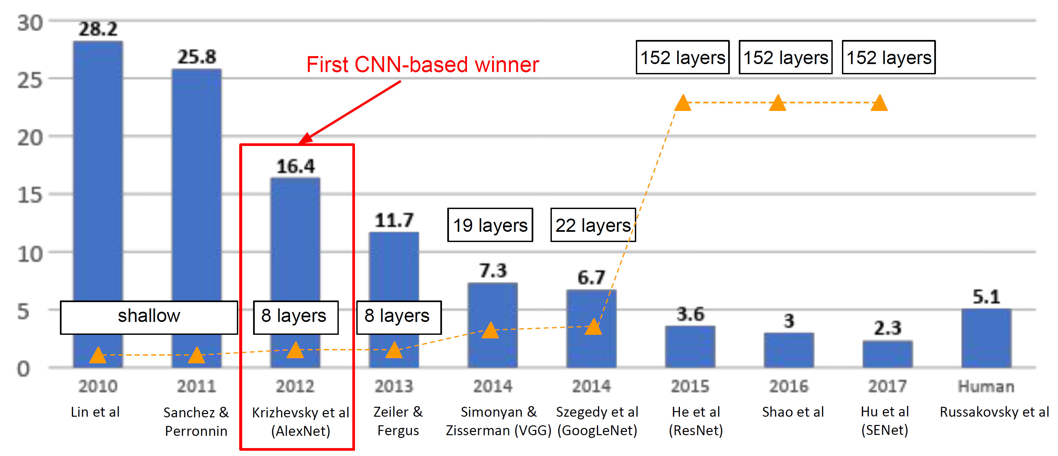
ImageNet Large Scale Visual Recognition Challenge (ILSVRC) winners

Slide 20
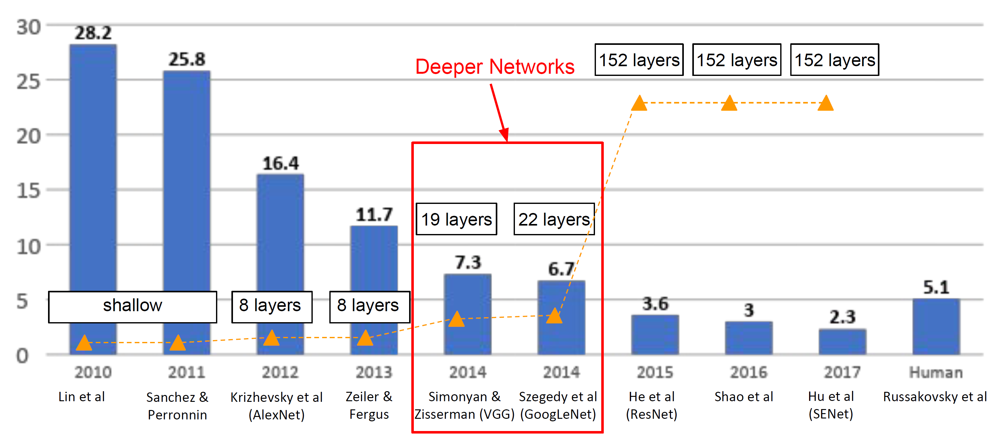
ImageNet Large Scale Visual Recognition Challenge (ILSVRC) winners

Slide 21
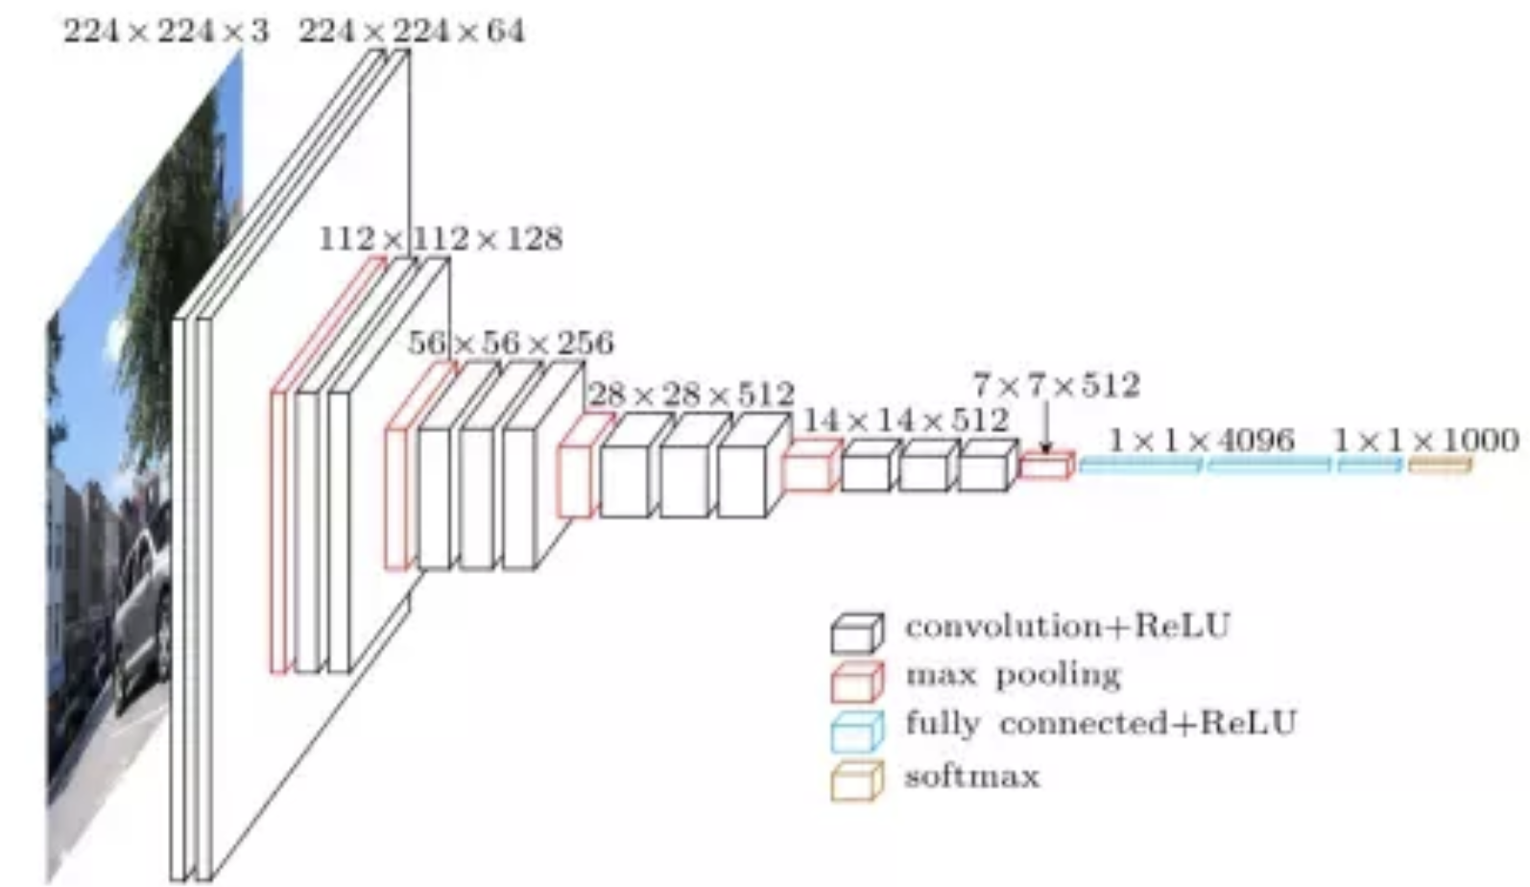
VGG
Simonyan, Karen, and Andrew Zisserman. "Very deep convolutional networks for large-scale image recognition." arXiv preprint arXiv:1409.1556 (2014).

Slide 22
VGG
AlexNet is deeper and bigger than LeNet to get performance
Go even bigger & deeper?
Options
More dense layers (too expensive)
More convolutions
Group into blocks

Slide 23
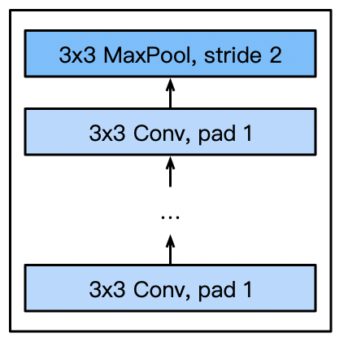
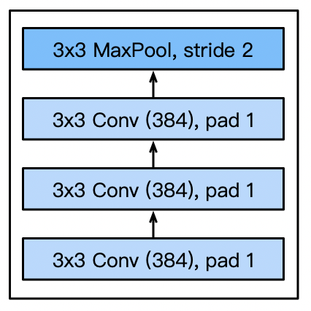
VGG Blocks
Deeper vs. wider?
5x5 convolutions
3x3 convolutions (more)
Deep & narrow better
VGG block
3x3 convolutions (pad 1) (n layers, m channels)
2x2 max-pooling (stride 2)
VGG block
Part of AlexNet

Slide 24
VGG
Q: Why use smaller filters? (3x3 conv)
Stack of three 3x3 conv (stride 1) layers has same effective receptive field as one 7x7 conv layer
But deeper, more non-linearities
And fewer parameters: 3 * (3²C²) vs. 7²C² for C channels per layer
VGG16
VGG19

Slide 25
VGG
Q: What is the effective receptive field of three 3x3 conv (stride 1) layers?
Input
A1
A2
A3
Conv1 (3x3)
Conv2 (3x3)
Conv3 (3x3)
VGG16
VGG19

Slide 26
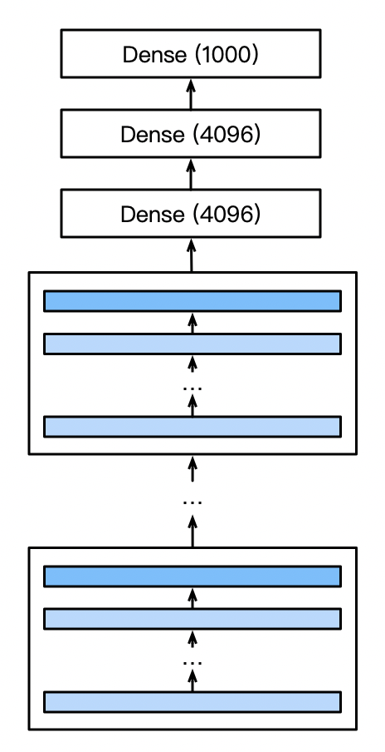
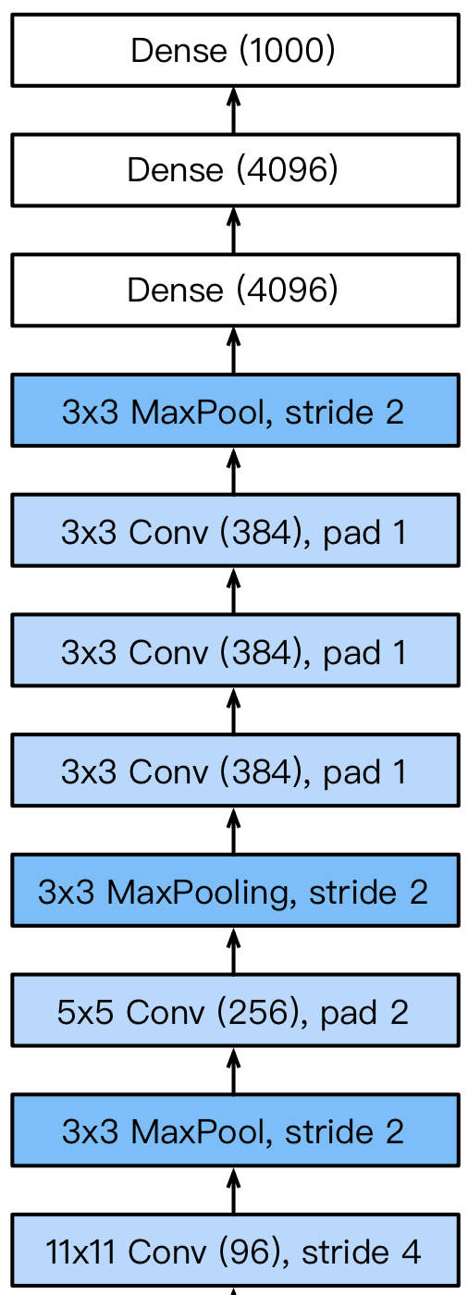
VGG Architecture
VGG
AlexNet
Multiple VGG blocks followed by dense layers
Vary the repeating number to get different architectures, such as VGG-16, VGG-19, …

Slide 27
Progress
LeNet (1995)
2 convolution + pooling layers
2 hidden dense layers
AlexNet (2012)
Bigger and deeper LeNet
ReLu, Dropout, preprocessing
VGG (2014)
Bigger and deeper AlexNet (repeated VGG blocks)

Slide 28
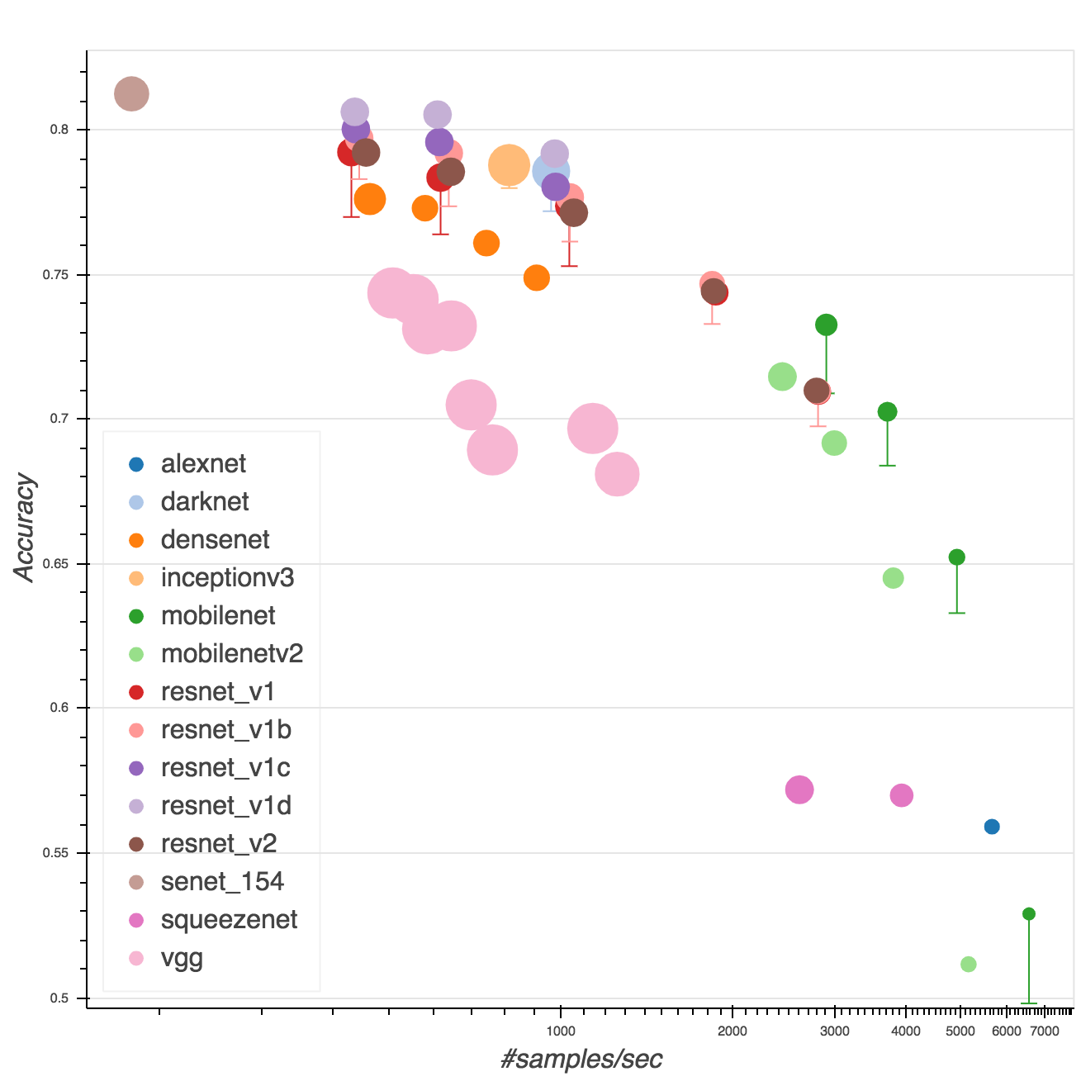
PyTorch Model Zoo
https://pytorch.org/docs/stable/torchvision/models.html
VGG
AlexNet

Slide 29
“Modern” CNN Architectures

Slide 30
GoogLeNet/Inception
Szegedy, Christian, et al. "Going deeper with convolutions." CVPR. 2015.

Slide 31
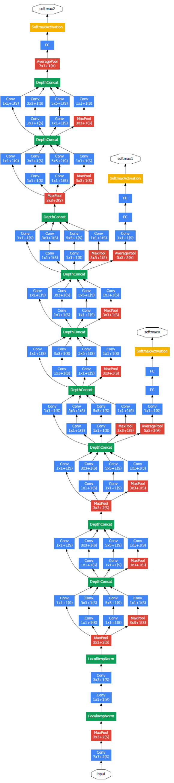
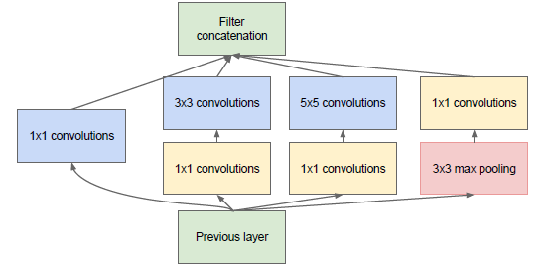
GoogLeNet
Deeper networks, with computational efficiency
ILSVRC’14 classification winner (6.7% top 5 error)
22 layers
No FC layers
Only 5 million parameters!
12x less than AlexNet
27x less than VGG-16

Slide 32
Picking the best convolution …
1x1
3x3
5x5
LeNet
AlexNet
VGG

Slide 33
Picking the best convolution …
1x1
3x3
5x5
LeNet
AlexNet
VGG
Why choose? Just pick them all.

Slide 34
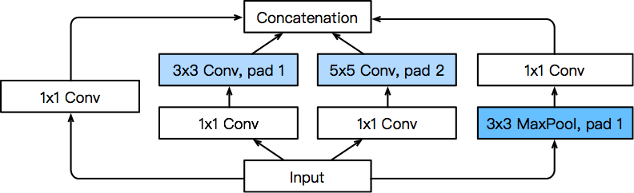
Inception Blocks
4 paths extract information from different aspects, then concatenate along the output channel
Same width/ height as input
Extract with different spatial size convolutions
Extract spatial info with pooling

Slide 35
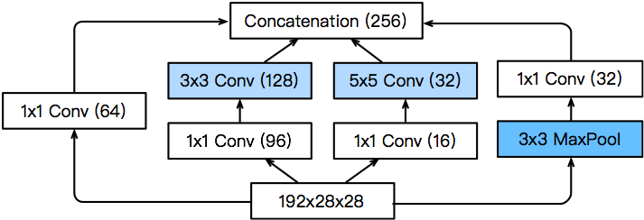
Inception Blocks
4 paths extract information from different aspects, then concatenate along the output channel
Allocate various capacities to each channel
Reduce channel size to lower model capacity

Slide 36
Inception Blocks
Inception blocks have fewer parameters and less computation complexity than a single 3*3 or 5*5 convolutional layer
Mix of different functions (powerful function class)
Memory and compute efficiency (good generalization)
 | #parameters | FLOPS
Inception | 0.16 M | 128 M
3x3 Conv | 0.44 M | 346 M
5x5 Conv | 1.22 M | 963 M

Slide 37
GoogLeNet
Stack of the “Inception” modules

Slide 38
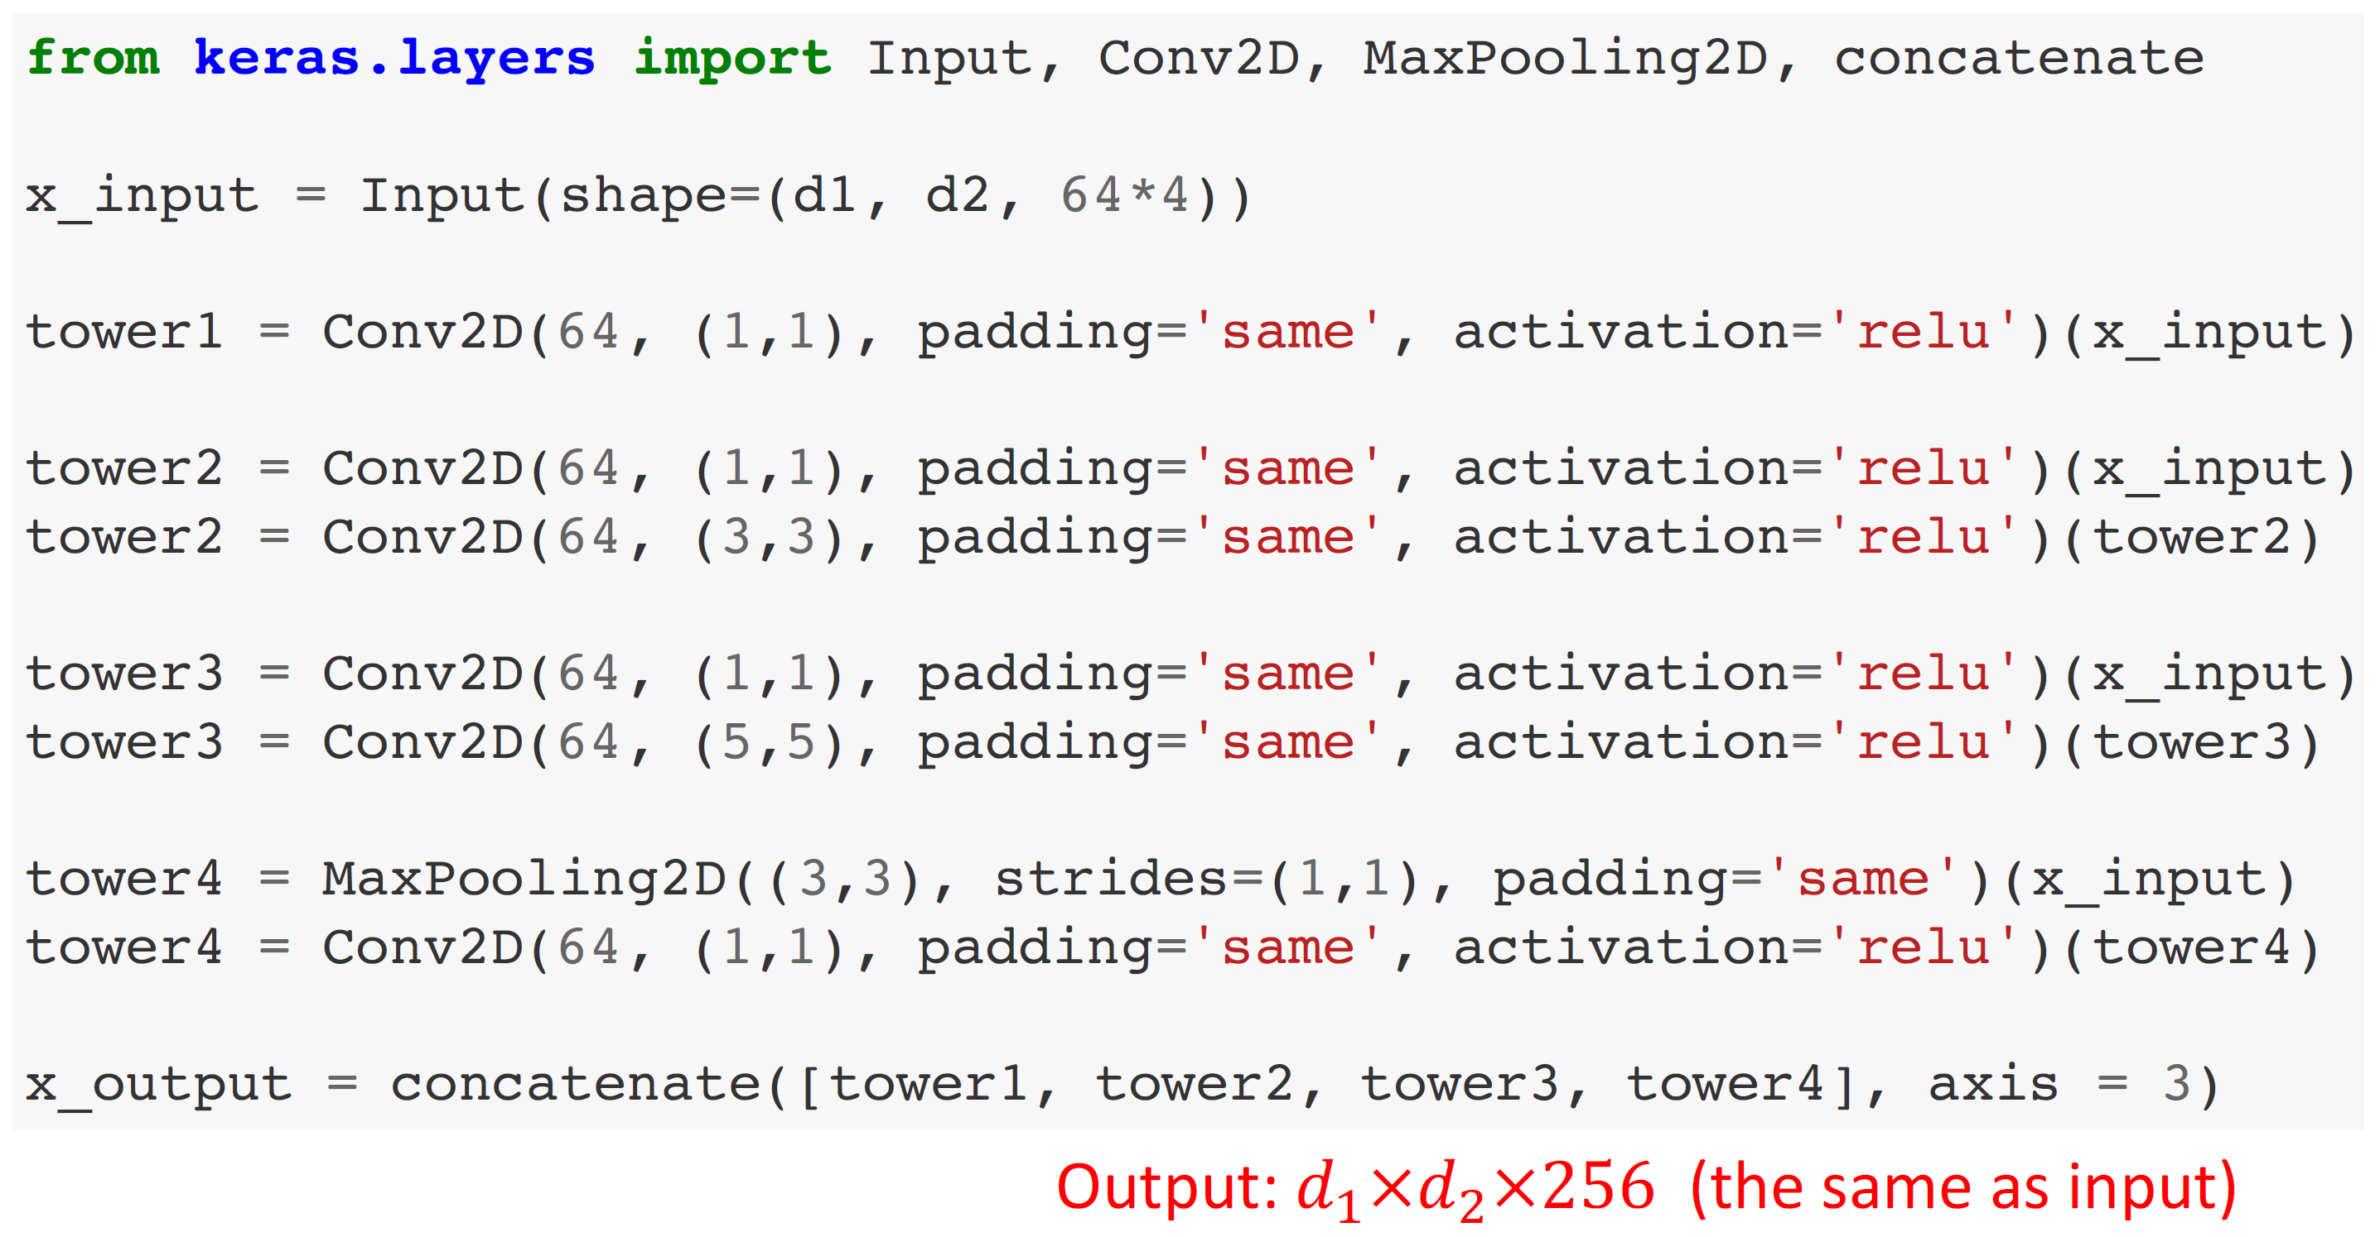
GoogLeNet

Slide 39
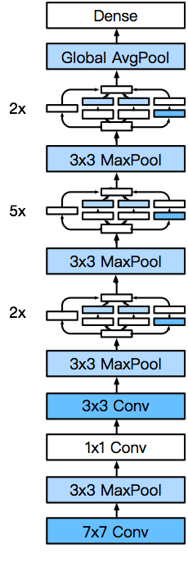
GoogLeNet
Output
Stage 5
5 stages with 9 inceptions blocks
Stage 4
Stage 3
Stage 2
Stage 1

Slide 40
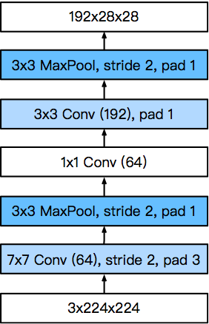
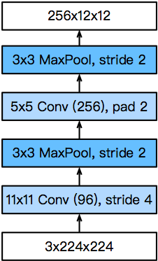
GoogLeNet—Stages 1&2
A simple ConvNet
3 Conv + 2 Pooling + 2 Normalization Layers
Smaller kernel size and output channels due to more layers
GoogLeNet
AlexNet

Slide 41
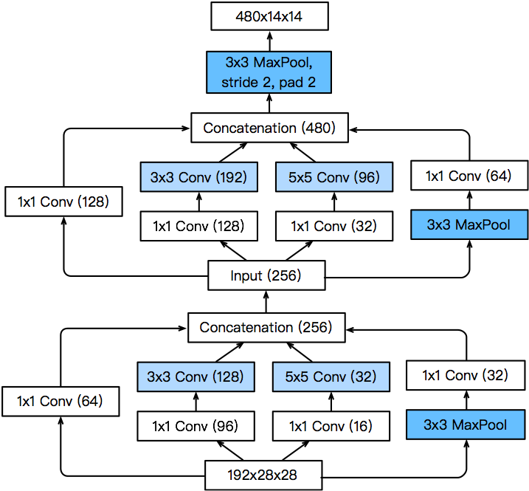
GoogLeNet—Stage 3
Increased output channel
Channels allocation is different

Slide 42
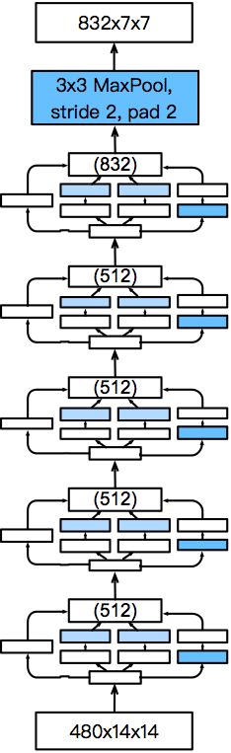
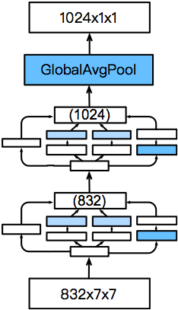
GoogLeNet—Stages 4&5
Increased output channel
1024-dim feature to output layer
Increased output channel
Increased output channel

Slide 43
GoogLeNet
Stack of 9 Inception modules

Slide 44
GoogLeNet – Output Layers
softmax2
Using AveragePool instead of Flatten.
AveragePool Layer for reducing the number of parameters.
SoftmaxActivation
Shape: 1000
FC
Shape: 1×1×1024
Question: If AveragePool is replaced by Flatten, then what will be #params in the FC layer?
AveragePool 7x7+1(V)
Shape: 7×7×1024
DepthConcat

Slide 45
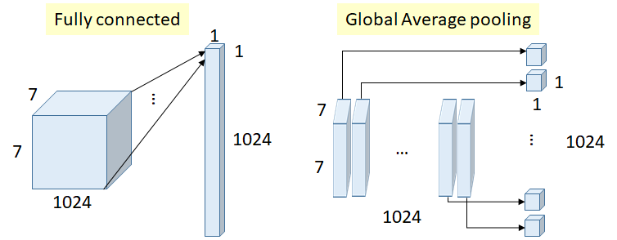
GoogLeNet – Output Layers
a move from FC layers to average pooling improved the top-1 accuracy by about 0.6%.
Global Average Pooling
Number of weights (connections) above = 7×7×1024×1024 = 51.3M
Number of weights = 0
https://medium.com/coinmonks/paper-review-of-googlenet-inception-v1-winner-of-ilsvlc-2014-image-classification-c2b3565a64e7

Slide 46
GoogLeNet – Auxiliary outputs
softmax1
During Training:
Inject additional gradient at lower layers
Make the optimization easier
During Test:
Disable the auxiliary outputs
SoftmaxActivation
FC
FC
Conv 1x1+1(S)
AveragePool 5x5+3(V)

Slide 47
The many flavors of Inception Networks
Inception-BN (V2) - Add batch normalization
Inception-V3 - Modified the inception block
Replace 5x5 by multiple 3x3 convolutions
Replace 5x5 by 1x7 and 7x1 convolutions
Replace 3x3 by 1x3 and 3x1 convolutions
Generally deeper stack
Inception-V4 - Add residual connections (more later)

Slide 48
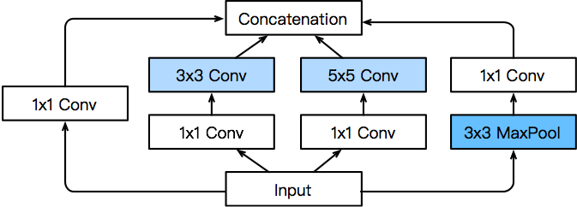
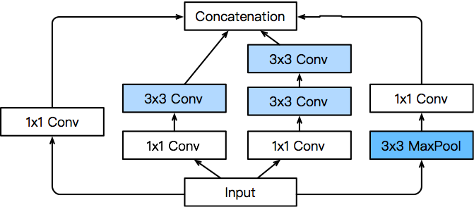
Inception V3 Block for Stage 3
Output
Stage 5
Stage 4
Stage 3
Stage 2
Stage 1

Slide 49
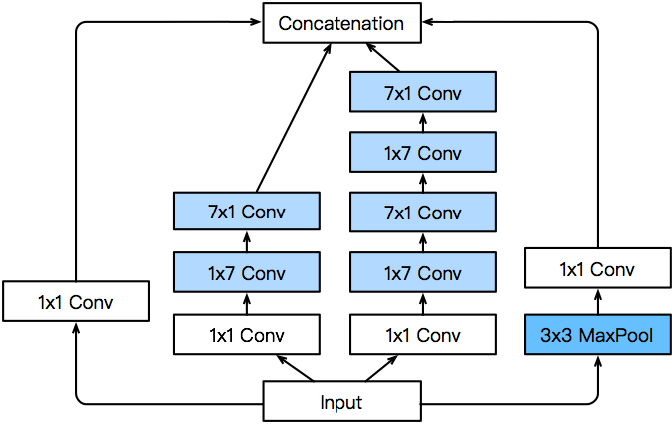
Inception V3 Block for Stage 4
Output
Stage 5
Stage 4
Stage 3
Stage 2
Stage 1

Slide 50
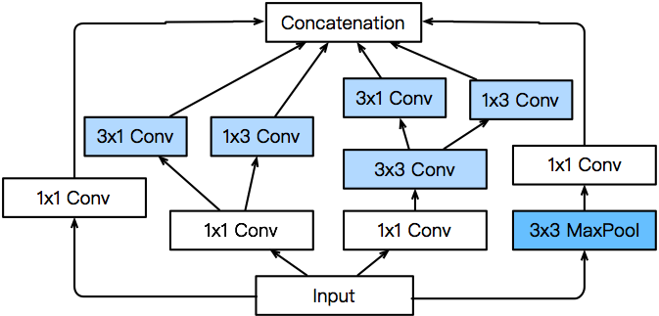
Inception V3 Block for Stage 5
Output
Stage 5
Stage 4
Stage 3
Stage 2
Stage 1

Slide 51
Inception V3

Slide 52
How deep can we go?
LeNet-5: 2 Conv + 2 FC layers.
AlexNet: 5 Conv + 3 FC layers.
VGG16: 13 Conv + 2 FC layers.
classic architectures (sequential)
Question: Why VGG16 and VGG19? Why not deeper classic architectures?

Slide 53
How deep can we go?
LeNet-5: 2 Conv + 2 FC layers.
AlexNet: 5 Conv + 3 FC layers.
VGG16: 13 Conv + 2 FC layers.
classic architectures (sequential)
Question: Why VGG16 and VGG19? Why not deeper classic architectures?
Answer: Deeper nets have worse training and test errors.
56-layer
Training error
56-layer
Test error
20-layer
20-layer
Iterations
Iterations

Slide 54
How deep can we go?
LeNet-5: 2 Conv + 2 FC layers.
AlexNet: 5 Conv + 3 FC layers.
VGG16: 13 Conv + 2 FC layers.
classic architectures (sequential)
Question: What makes deeper VGG nets worse?
Answer: It is bad optimization, not overfitting.
56-layer
Training error
56-layer
Test error
20-layer
20-layer
Iterations
Iterations

Slide 55
How deep can we go?
LeNet-5: 2 Conv + 2 FC layers.
AlexNet: 5 Conv + 3 FC layers.
VGG16: 13 Conv + 2 FC layers.
classic architectures (sequential)
Question: What makes deeper VGG nets worse?
The vanishing gradient problem.
Derivative of the loss function w.r.t. a bottom layer can be vanishingly small.
It makes deep nets difficult to optimize. The bottom layers are not well trained.
The model is good; but you cannot find a good local minimum.

Slide 56
How deep can we go?
LeNet-5: 2 Conv + 2 FC layers.
AlexNet: 5 Conv + 3 FC layers.
VGG16: 13 Conv + 2 FC layers.
Inception: 21 Conv + 1 FC layers
classic architectures (sequential)
Question: Why can Inception go deeper than VGG16?

Slide 57
How deep can we go?
LeNet-5: 2 Conv + 2 FC layers.
AlexNet: 5 Conv + 3 FC layers.
VGG16: 13 Conv + 2 FC layers.
Inception: 21 Conv + 1 FC layers
classic architectures (sequential)
Question: Why can Inception go deeper than VGG16?
Auxiliary outputs inject additional gradient at lower layers.

Slide 58
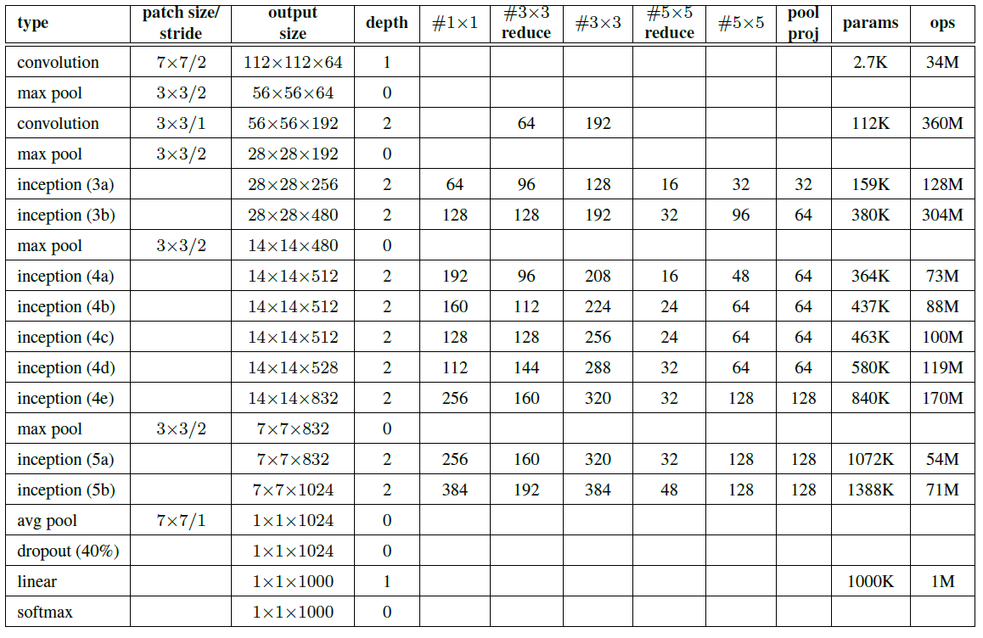
Details about Parameters of Each Layer in GoogLeNet Network (From Top to Bottom)
Notes:
https://medium.com/coinmonks/paper-review-of-googlenet-inception-v1-winner-of-ilsvlc-2014-image-classification-c2b3565a64e7

Slide 59
How deep can we go?
7x7 conv, 64, /2
pool, /2
3x3 conv, 64
3x3 conv, 64
3x3 conv, 64
3x3 conv, 64
3x3 conv, 64
3x3 conv, 64
3x3 conv, 128, /2
LeNet-5: 2 Conv + 2 FC layers.
AlexNet: 5 Conv + 3 FC layers.
VGG16: 13 Conv + 2 FC layers.
Inception: 21 Conv + 1 FC layers
ResNet: Up to 151 Conv + 1 FC layers
3x3 conv,
3x3 conv, 3x3 conv,
128
128
128
classic architectures (sequential)
3x3 conv, 128
3x3 conv, 128
3x3 conv, 128
3x3 conv, 128
3x3 conv, 25
3x3 conv, 3x3 conv,
6, /2
256
256
modern architectures
3x3 conv, 256
3x3 conv, 256
3x3 conv, 256
3x3 conv, 256
3x3 conv, 256
3x3 conv, 256
3x3 conv, 256
ResNet’s key idea: skip connections for curing vanishing gradient.
3x3 conv, 256
3x3 conv, 256
3x3 conv, 512, /2
3x3 conv, 512
3x3 conv, 512
3x3 conv, 512
3x3 conv, 512
3x3 conv, 512
avg pool
fc 1000

Slide 60


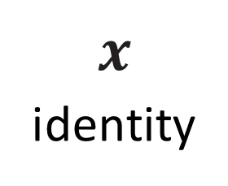
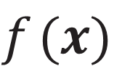

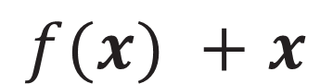
ResNet [He et al. 2015]
7x7 conv, 64, /2
pool, /2
3x3 conv, 64
3x3 conv, 64
3x3 conv, 64
3x3 conv, 64
3x3 conv, 64
3x3 conv, 64
3x3 conv, 128, /2
3x3 conv,
3x3 conv, 3x3 conv,
128
A block of ResNet
128
128
3x3 conv, 128
$$x$$
3x3 conv, 128
3x3 conv, 128
3x3 conv, 128
3x3 conv, 25
3x3 conv, 3x3 conv,
6, /2
weight layer
 | relu
256
256
3x3 conv, 256
$$f(x)$$
3x3 conv, 256
$$x$$
identity
3x3 conv, 256
3x3 conv, 256
weight layer
3x3 conv, 256
3x3 conv, 256
3x3 conv, 256
3x3 conv, 256
3x3 conv, 256
$$f(x) + x$$
3x3 conv, 512, /2
3x3 conv, 512
relu
3x3 conv, 512
3x3 conv, 512
3x3 conv, 512
3x3 conv, 512
avg pool
fc 1000

Slide 61
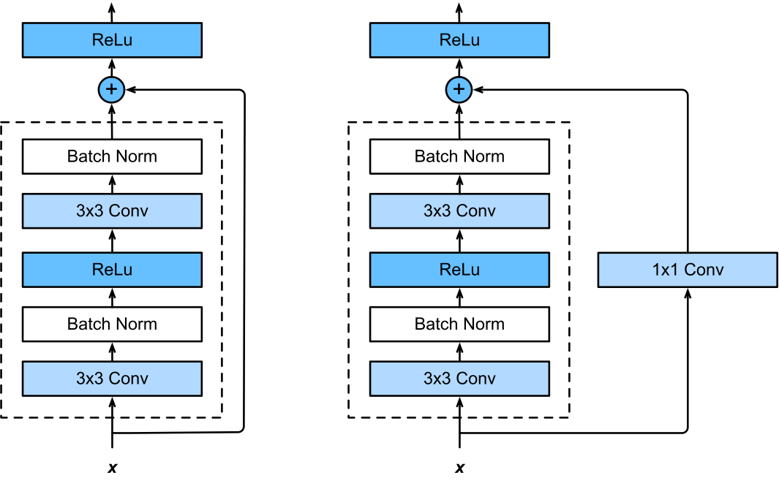
ResNet Block in detail

Slide 62
ResNet 152

Slide 63
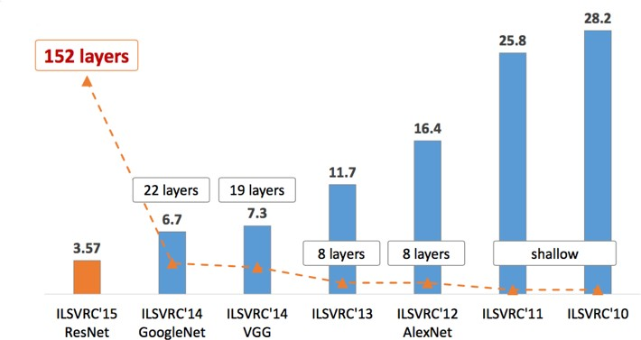
Winners of the ImageNet Challenge
number of layers
top-5 error rate

Slide 64
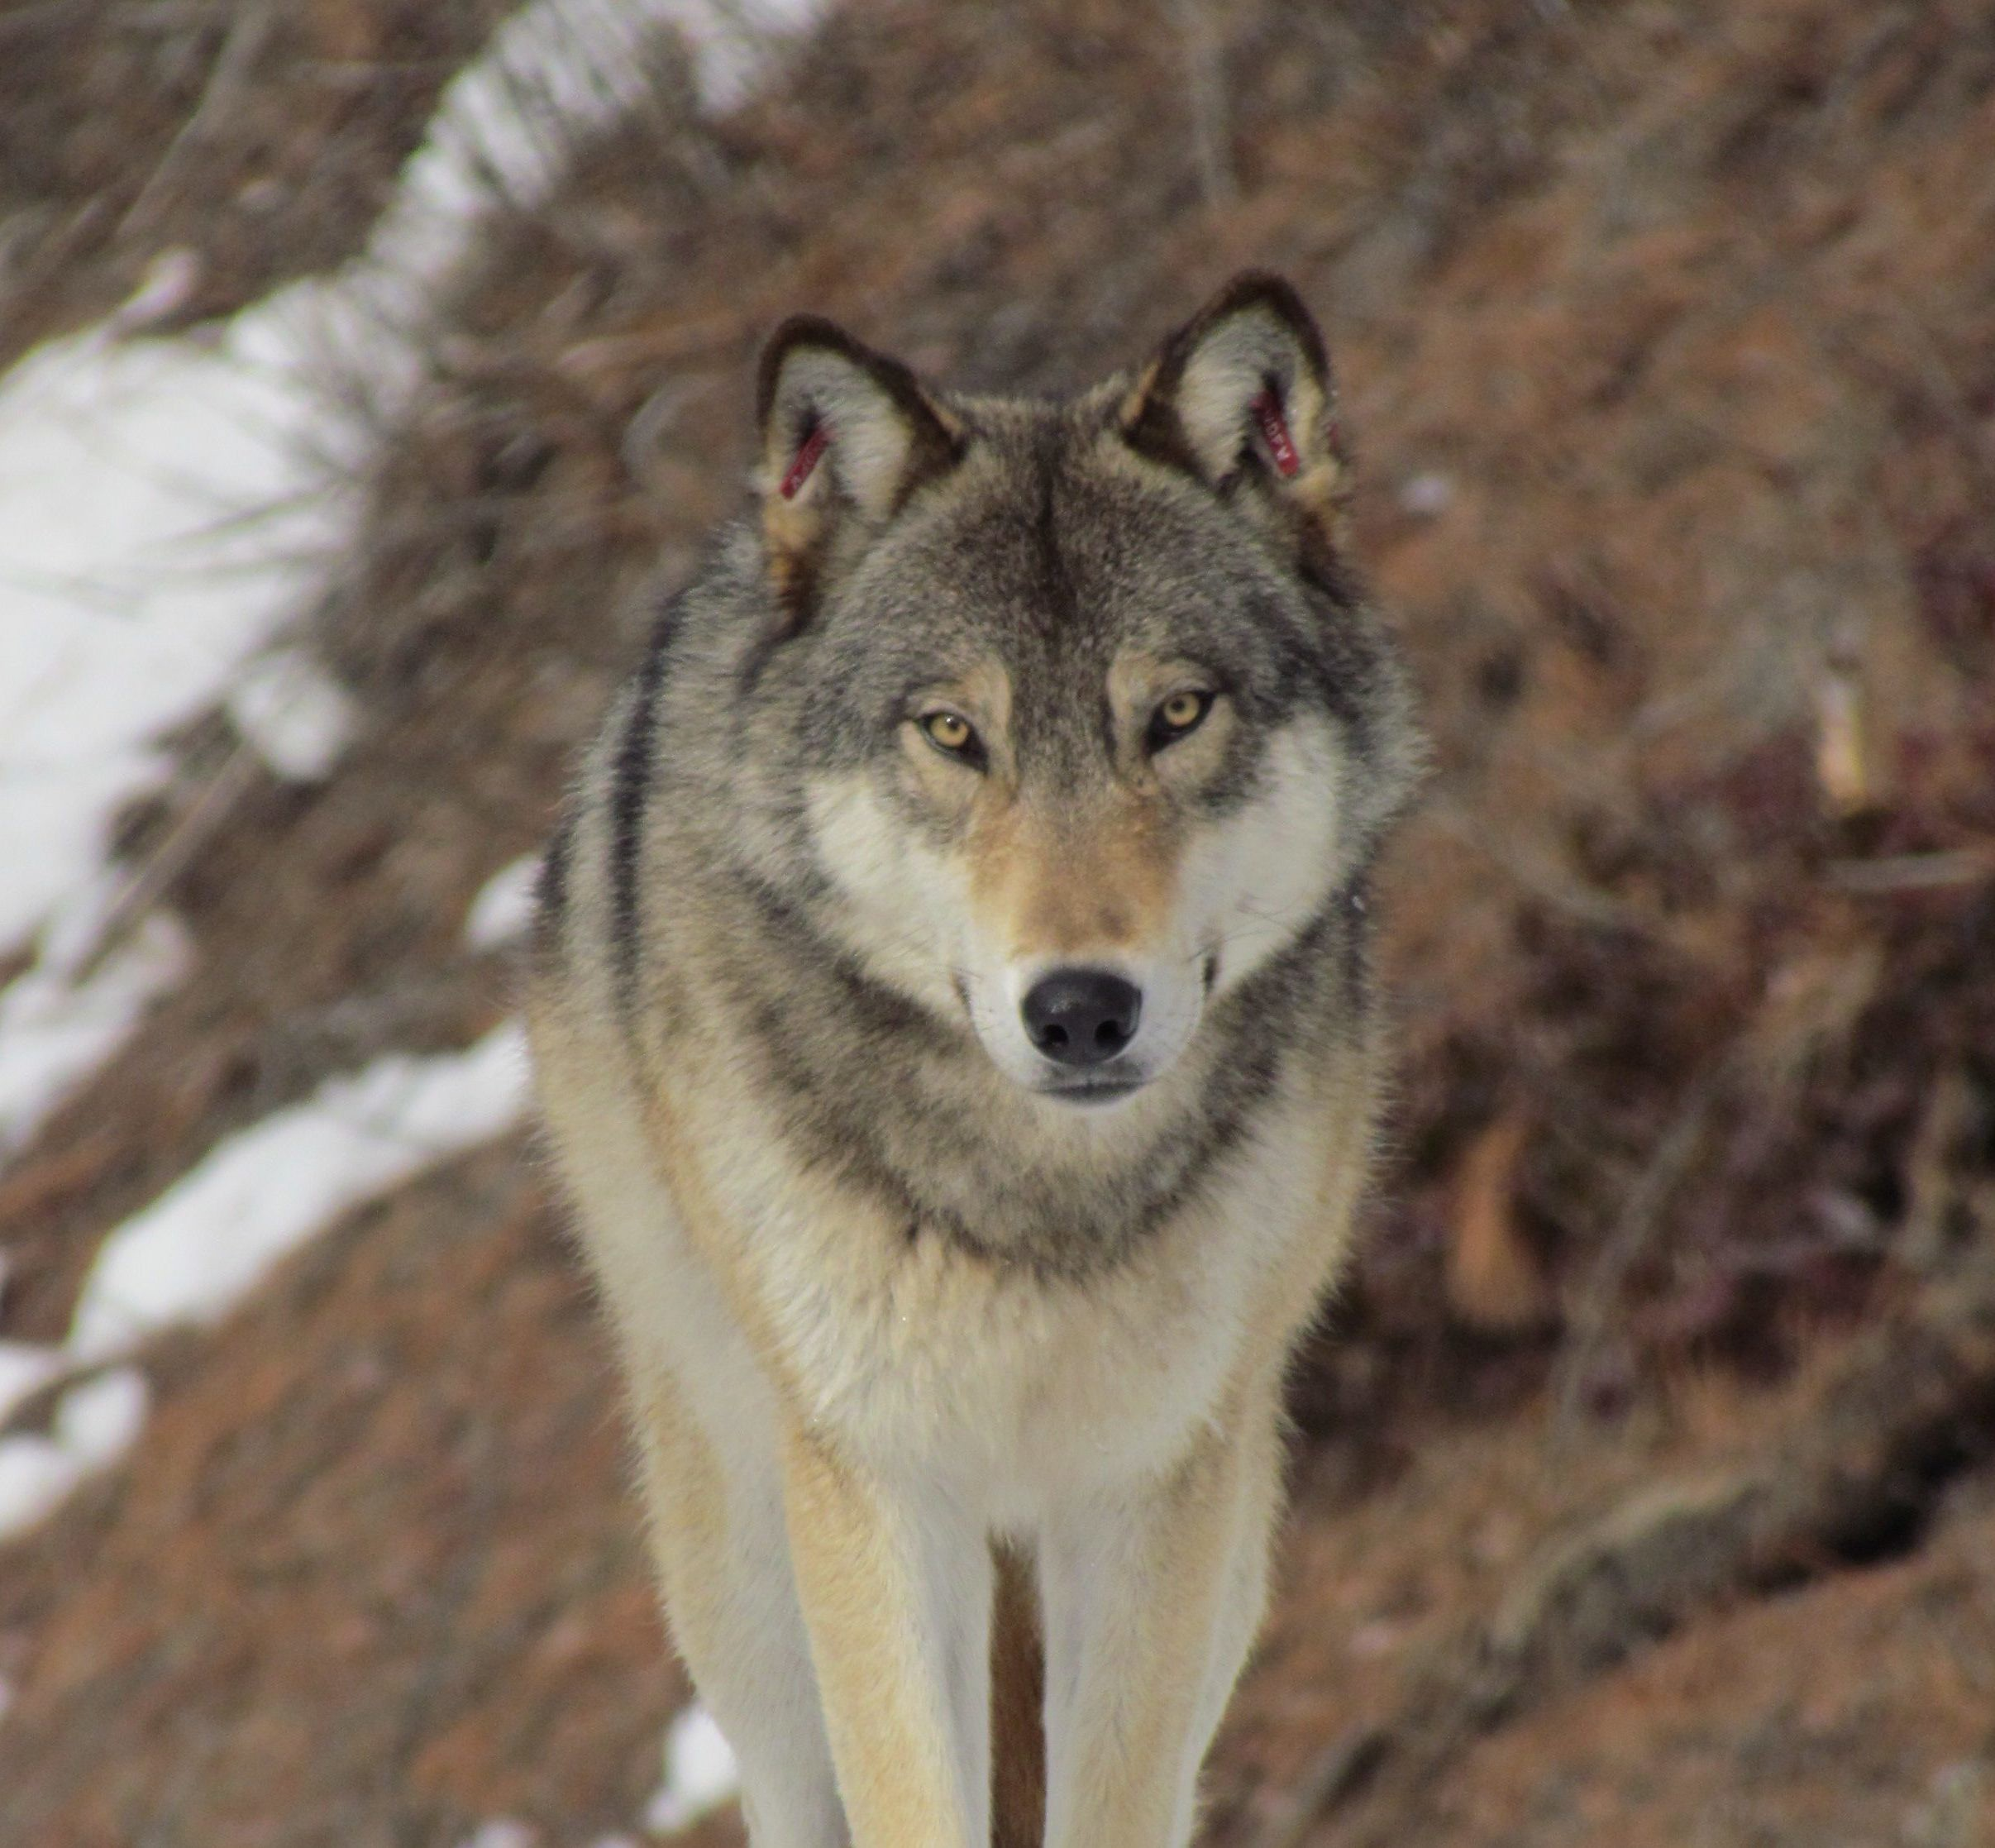






Classification Error: Top-1 vs. Top-5
class
pred. probability
husky
wolf
dog
fox
snow
fur
forest
0.50
0.20
0.18
0.08
0.01
0.01
0.01
ConvNet
Label: “wolf”
⋯

Slide 65
Classification Error: Top-1 vs. Top-5
class
pred. probability
husky
wolf
dog
fox
snow
fur
forest
0.50
0.20
0.18
0.08
0.01
0.01
0.01
ConvNet
Evaluated by the Top-1 error, this prediction is wrong!
Label: “wolf”
⋯

Slide 66
Classification Error: Top-1 vs. Top-5
class
pred. probability
husky
wolf
dog
fox
snow
fur
forest
0.50
0.20
0.18
0.08
0.01
0.01
0.01
ConvNet
Evaluated by the Top-5 error, the prediction is correct!
Label: “wolf”
⋯

Slide 67
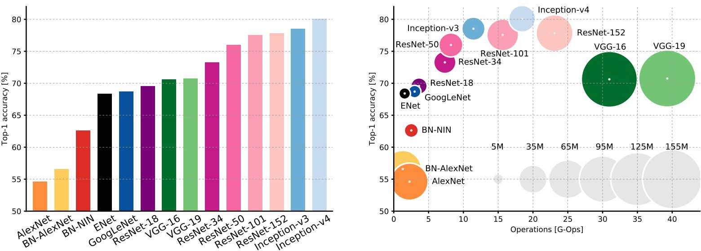
Comparing complexity...
An Analysis of Deep Neural Network Models for Practical Applications, 2017.
Figures copyright Alfredo Canziani, Adam Paszke, Eugenio Culurciello, 2017. Reproduced with permission.
67
May 5, 2020
From Fei-Fei Li, Ranjay Krishna, Danfei Xu

Slide 68
Comparing complexity...
Inception-v4: Resnet + Inception!
An Analysis of Deep Neural Network Models for Practical Applications, 2017.
Figures copyright Alfredo Canziani, Adam Paszke, Eugenio Culurciello, 2017. Reproduced with permission.
68
May 5, 2020
From Fei-Fei Li, Ranjay Krishna, Danfei Xu

Slide 69
Comparing complexity...
VGG: most parameters, most operations
An Analysis of Deep Neural Network Models for Practical Applications, 2017.
Figures copyright Alfredo Canziani, Adam Paszke, Eugenio Culurciello, 2017. Reproduced with permission.
69
May 5, 2020

Slide 70
GoogLeNet: most efficient
Comparing complexity...
An Analysis of Deep Neural Network Models for Practical Applications, 2017.
Figures copyright Alfredo Canziani, Adam Paszke, Eugenio Culurciello, 2017. Reproduced with permission.

Slide 71
AlexNet:
Smaller compute, still memory heavy, lower accuracy
Comparing complexity...
An Analysis of Deep Neural Network Models for Practical Applications, 2017.
Figures copyright Alfredo Canziani, Adam Paszke, Eugenio Culurciello, 2017. Reproduced with permission.
71
May 5, 2020
From Fei-Fei Li, Ranjay Krishna, Danfei Xu

Slide 72
ResNet:
Moderate efficiency depending on model, highest accuracy
Comparing complexity...
An Analysis of Deep Neural Network Models for Practical Applications, 2017.
Figures copyright Alfredo Canziani, Adam Paszke, Eugenio Culurciello, 2017. Reproduced with permission.
72
May 5, 2020
From Fei-Fei Li, Ranjay Krishna, Danfei Xu

Slide 73
Summary

Slide 74
CNN Architectures
LeNet-5: 2 Conv + 2 FC layers.
AlexNet: 5 Conv + 3 FC layers.
VGG16: 13 Conv + 2 FC layers.
classic architectures (sequential)

Slide 75
CNN Architectures
LeNet-5: 2 Conv + 2 FC layers.
AlexNet: 5 Conv + 3 FC layers.
VGG16: 13 Conv + 2 FC layers.
classic architectures (sequential)
Question: Can the classic architectures go deeper?
Answer: No.
Deeper nets have worse training and test errors.
Vanishing gradient.

Slide 76
CNN Architectures
LeNet-5: 2 Conv + 2 FC layers.
AlexNet: 5 Conv + 3 FC layers.
VGG16: 13 Conv + 2 FC layers.
classic architectures (sequential)
Inception: 21 Conv + 1 FC layers.
ResNet: Up to 151 Conv + 1 FC layers.
modern architectures

Slide 77
CNN Architectures
LeNet-5: 2 Conv + 2 FC layers.
AlexNet: 5 Conv + 3 FC layers.
VGG16: 13 Conv + 2 FC layers.
classic architectures (sequential)
Inception: 21 Conv + 1 FC layers.
ResNet: Up to 151 Conv + 1 FC layers.
modern architectures
Tricks:
Inception: auxiliary output (gradient injection).
ResNet: skip connection.

Slide 78
Take-Home Message
AlexNet showed that you can use CNNs to train Computer Vision models.
VGG shows that bigger networks work better
GoogLeNet is one of the first to focus on efficiency using 1x1 bottleneck convolutions and global avg pool instead of FC layers
ResNet showed us how to train extremely deep networks
Limited only by GPU & memory!
Showed diminishing returns as networks got bigger
After ResNet: CNNs were better than the human metric and focus shifted to efficient networks:
Lots of tiny networks aimed at mobile devices: MobileNet, ShuffleNet
Neural Architecture Search can now automate architecture design

Slide 79
Beyond the Accuracy

Slide 80

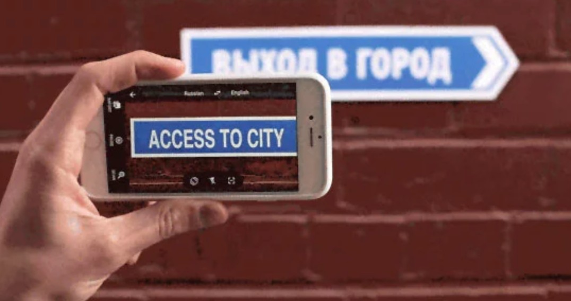
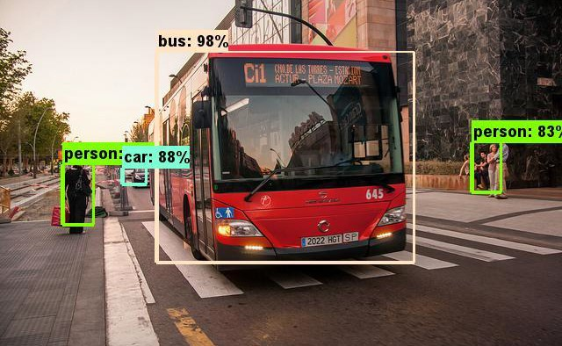



Deep Learning on the Edge
Object Detection
OCR & Translation
Photo by Juanedc (CC BY 2.0)
Face Attributes
Speech Recognition &
Translation
Google Doodle by Sarah Harrison

Slide 81
Solution 1: Could Computing

Slide 82




Solution 1: Could Computing

Slide 83

Solution 1: Could Computing

Slide 84
Solution 1: Could Computing
Bonjour

Slide 85

Solution 1: Could Computing

Slide 86
Solution 1: Could Computing
softmax2
SoftmaxActivation
FC
AveragePool 7x7+1(V)
DepthConcat
Conv Conv Conv Conv 1x1+1(S) 3x3+1(S) 5x5+1(S) 1x1+1(S)
Conv Conv MaxPool 1x1+1(S) 1x1+1(S) 3x3+1(S)
DepthConcat
Conv Conv Conv Conv 1x1+1(S) 3x3+1(S) 5x5+1(S) 1x1+1(S)
softmax1
Conv Conv MaxPool 1x1+1(S) 1x1+1(S) 3x3+1(S)
SoftmaxActivation
MaxPool 3x3+2(S)
FC
DepthConcat
FC
Conv Conv Conv Conv Conv 1x1+1(S) 3x3+1(S) 5x5+1(S) 1x1+1(S) 1x1+1(S)
Conv Conv MaxPool AveragePool 1x1+1(S) 1x1+1(S) 3x3+1(S) 5x5+3(V)
DepthConcat
Conv Conv Conv Conv 1x1+1(S) 3x3+1(S) 5x5+1(S) 1x1+1(S)
Conv Conv MaxPool 1x1+1(S) 1x1+1(S) 3x3+1(S)
DepthConcat
softmax0
Conv Conv Conv Conv 1x1+1(S) 3x3+1(S) 5x5+1(S) 1x1+1(S)
SoftmaxActivation
Conv Conv MaxPool 1x1+1(S) 1x1+1(S) 3x3+1(S)
FC
DepthConcat
FC
Conv Conv Conv Conv Conv 1x1+1(S) 3x3+1(S) 5x5+1(S) 1x1+1(S) 1x1+1(S)
Conv Conv MaxPool AveragePool 1x1+1(S) 1x1+1(S) 3x3+1(S) 5x5+3(V)
DepthConcat
Conv Conv Conv Conv 1x1+1(S) 3x3+1(S) 5x5+1(S) 1x1+1(S)
Conv Conv MaxPool 1x1+1(S) 1x1+1(S) 3x3+1(S)
MaxPool 3x3+2(S)
DepthConcat
Conv Conv Conv Conv 1x1+1(S) 3x3+1(S) 5x5+1(S) 1x1+1(S)
Conv Conv MaxPool 1x1+1(S) 1x1+1(S) 3x3+1(S)
DepthConcat
Conv Conv Conv Conv 1x1+1(S) 3x3+1(S) 5x5+1(S) 1x1+1(S)
Conv Conv MaxPool 1x1+1(S) 1x1+1(S) 3x3+1(S)
MaxPool 3x3+2(S)
LocalRespNorm
Conv 3x3+1(S)
Conv 1x1+1(V)
LocalRespNorm
MaxPool 3x3+2(S)
Conv 7x7+2(S)
input

Slide 87
Solution 1: Could Computing
softmax2
SoftmaxActivation
FC
AveragePool 7x7+1(V)
DepthConcat
Conv Conv Conv Conv 1x1+1(S) 3x3+1(S) 5x5+1(S) 1x1+1(S)
Conv Conv MaxPool 1x1+1(S) 1x1+1(S) 3x3+1(S)
DepthConcat
Conv Conv Conv Conv 1x1+1(S) 3x3+1(S) 5x5+1(S) 1x1+1(S)
softmax1
Conv Conv MaxPool 1x1+1(S) 1x1+1(S) 3x3+1(S)
SoftmaxActivation
MaxPool 3x3+2(S)
FC
DepthConcat
FC
Conv Conv Conv Conv Conv 1x1+1(S) 3x3+1(S) 5x5+1(S) 1x1+1(S) 1x1+1(S)
Conv Conv MaxPool AveragePool 1x1+1(S) 1x1+1(S) 3x3+1(S) 5x5+3(V)
DepthConcat
Conv Conv Conv Conv 1x1+1(S) 3x3+1(S) 5x5+1(S) 1x1+1(S)
Conv Conv MaxPool 1x1+1(S) 1x1+1(S) 3x3+1(S)
DepthConcat
softmax0
Conv Conv Conv Conv 1x1+1(S) 3x3+1(S) 5x5+1(S) 1x1+1(S)
SoftmaxActivation
Conv Conv MaxPool 1x1+1(S) 1x1+1(S) 3x3+1(S)
FC
DepthConcat
FC
Name and ID
Conv Conv Conv Conv Conv 1x1+1(S) 3x3+1(S) 5x5+1(S) 1x1+1(S) 1x1+1(S)
Conv Conv MaxPool AveragePool 1x1+1(S) 1x1+1(S) 3x3+1(S) 5x5+3(V)
DepthConcat
Conv Conv Conv Conv 1x1+1(S) 3x3+1(S) 5x5+1(S) 1x1+1(S)
Conv Conv MaxPool 1x1+1(S) 1x1+1(S) 3x3+1(S)
MaxPool 3x3+2(S)
DepthConcat
Conv Conv Conv Conv 1x1+1(S) 3x3+1(S) 5x5+1(S) 1x1+1(S)
Conv Conv MaxPool 1x1+1(S) 1x1+1(S) 3x3+1(S)
DepthConcat
Conv Conv Conv Conv 1x1+1(S) 3x3+1(S) 5x5+1(S) 1x1+1(S)
Conv Conv MaxPool 1x1+1(S) 1x1+1(S) 3x3+1(S)
MaxPool 3x3+2(S)
LocalRespNorm
Conv 3x3+1(S)
Conv 1x1+1(V)
LocalRespNorm
MaxPool 3x3+2(S)
Conv 7x7+2(S)
input

Slide 88
Solution 1: Could Computing
Downsides:
Sending data between client and server is relatively slow (in comparing with local computation on the device.)
Sending data through 3G/4G/5G network may be charged.
User’s privacy.

Slide 89


Solution 2: Edge Computing

Slide 90

Solution 2: Edge Computing

Slide 91
Solution 2: Edge Computing
Run a ConvNet on the chip to make prediction.
(The ConvNet has been trained on the server.)

Slide 92
Solution 2: Edge Computing
Advantages:
Faster. (Computation is typically faster than communication.)
Avoid sending and receiving data.
Save money.
Works without internet.
Protect user’s privacy.
Shiba Inu
Run a ConvNet on the chip to make prediction.
(The ConvNet has been trained on the server.)

Slide 93
Solution 2: Edge Computing
Disadvantages:
Energy consumption. (Heavy matrix and tensor computation.)
Cost local memory and storage. (Deep ConvNets has at least millions of parameters.)
Advantages:
Faster. (Computation is typically faster than communication.)
Avoid sending and receiving data.
Save money.
Works without internet.
Protect user’s privacy.
Shiba Inu
Run a ConvNet on the chip to make prediction.
(The ConvNet has been trained on the server.)

Slide 94
Cloud Computing V.S. Edge Computing
Edge computing is more popular for the deep learning tasks (at present).
Research: deep learning on the edge
Less float point operations (FLOPs). (Thus less energy consumption.)
Less network parameters. (Thus less memory and storage.)

Slide 95
MobileNet [Howard et al. 2017]
Motivations
Small enough to fit in an iPhone (just 4M parameters).
Less computation than the standard ConvNets.
Key idea: Depthwise separable convolution.
Paper: https://arxiv.org/pdf/1704.04861.pdf
Further reading:
http://machinethink.net/blog/googles-mobile-net-architecture-on-iphone/
https://medium.com/@yu4u/why-mobilenet-and-its-variants-e-g-shufflenet-are-fast-1c7048b9618d

Slide 96



Convolution
Regular Convolutional Layer
One $k_{1}∗k_{2}∗d_{3}$ filter
$d_{1}∗d_{2}∗d_{3}$ input

Slide 97



Convolution
Regular Convolutional Layer
Depthwise Convolutional Layer
One $k_{1}∗k_{2}∗d_{3}$ filter
One $k_{1}∗k_{2}$ filter
$d_{1}∗d_{2}∗d_{3}$ input
$d_{1}∗d_{2}∗d_{3}$ input

Slide 98




Convolution
Regular Convolutional Layer
Depthwise Convolutional Layer
For $i=1$ to $d_{3}$ (each of the slides)
Compute the convolution of the $i$-th slide (shape $d_{1}∗d_{2}$) and the filter (shape $k_{1}∗k_{2}$)
Output: a matrix (shape $d_{1}∗d_{2}$)
Thus the final output is $d_{1}∗d_{2}∗d_{3}$
$d_{1}∗d_{2}∗d_{3}$ input
$d_{1}∗d_{2}∗d_{3}$ output

Slide 99




Convolution
Regular Convolutional Layer
Depthwise Convolutional Layer
One $k_{1}∗k_{2}∗d_{3}$ filter
One $k_{1}∗k_{2}$ filter
$d_{1}∗d_{2}∗d_{3}$ input
$d_{1}∗d_{2}∗1$ output
$d_{1}∗d_{2}∗d_{3}$ input
$d_{1}∗d_{2}∗d_{3}$ output

Slide 100







MobileNet: Depthwise Conv + 1*1 Conv
Depthwise Convolutional Layer
1*1 convolutional layer
One $k_{1}∗k_{2}$ filter
One $1∗1∗d_{3}$ filter
$d_{1}∗d_{2}∗d_{3}$ input
$d_{1}∗d_{2}∗d_{3}$ output
$d_{1}∗d_{2}∗d_{3}$ input
$d_{1}∗d_{2}∗1$ output

Slide 101





MobileNet: Depthwise Conv + 1*1 Conv
Regular Convolutional Layer
Depthwise Conv + 1*1 Conv
$d_{1}∗d_{2}∗d_{3}$ input
$d_{1}∗d_{2}∗d_{3}$ input
$$d_{1}∗d_{2}∗d_{3}$$
$d_{1}∗d_{2}∗1$ output
$d_{1}∗d_{2}∗1$ output

Slide 102



MobileNet: Depthwise Conv + 1*1 Conv
Regular Convolutional Layer
Depthwise Conv + 1*1 Conv
$d_{1}∗d_{2}∗d_{3}$ input
$d_{1}∗d_{2}∗d_{3}$ input
$k_{1}∗k_{2}$ parameters
$$d_{1}∗d_{2}∗d_{3}$$
$k_{1}∗k_{2}∗d_{3}$ parameters
$d_{3}$ parameters
$d_{1}∗d_{2}∗1$ output
$d_{1}∗d_{2}∗1$ output

Slide 103
MobileNet: Depthwise Conv + 1*1 Conv
Regular Convolutional Layer
Depthwise Conv + 1*1 Conv
$d_{1}∗d_{2}∗d_{3}$ input
$d_{1}∗d_{2}∗d_{3}$ input
$k_{1}∗k_{2}$ parameters
$$d_{1}∗d_{2}∗d_{3}$$
$k_{1}∗k_{2}∗d_{3}$ parameters
$d_{3}$ parameters
$d_{1}∗d_{2}∗1$ output
$d_{1}∗d_{2}∗1$ output
Less Parameters!

Slide 104

MobileNet

Slide 105
Reduce Memory and Computation
Deploy a deep neural network to a smart device.
Challenges:
Computation ➔ Power consumption.
Parameters ➔ Storage and memory.

Slide 106
Reduce Memory and Computation
Deploy a deep neural network to a smart device.
Challenges:
Computation ➔ Power consumption.
Parameters ➔ Storage and memory.
MobileNet’s solutions:
Separable Convolution instead of Tensor Convolution.
AveragePool Layer instead of Flatten Layer. (Proposed by Inception Net.)

Slide 107
One more thing

Slide 108

Challenge of Face Recognition
Question: Why not using Softmax classifier (as in image recognition)

Slide 109
Challenge of Face Recognition
Question: Why not using Softmax classifier (as in image recognition)
Softmax classifier is a dense layer with Softmax activation
#class is large (can be millions or billions)
#parameters in the output layer is huge!
Suppose the input shape of Softmax classifier is 1K.
Suppose the #class is 10M.
Then #parameters = 1k*10M = 10G

Slide 110






Training: Randomly Sample a Triplet
positive
$$X^{+}$$
anchor
$$X^{a}$$
negative
$$X^{−}$$

Slide 111




Training: Feature Extraction using CNN
𝐟
positive
$$X^{+}$$
$${f(X}^{+})$$
𝐟
anchor
$$X^{a}$$
$${f(X}^{a})$$
𝐟
negative
$$X^{−}$$
$$f(X^{−})$$

Slide 112





Training: Loss Functions
𝐟
positive
$$X^{+}$$
$${f(X}^{+})$$
$${\left\|{f(X}^{+})−{f(X}^{a})\right\|}_{2}^{2}$$
𝐟
anchor
$$X^{a}$$
$${f(X}^{a})$$
$${\left\|{f(X}^{a})−f(X^{−}) \right\|}_{2}^{2}$$
𝐟
negative
$$X^{−}$$
$$f(X^{−})$$

Slide 113



Loss Functions
$N$ triplets: $(x_{1}^{a},x_{1}^{+},x_{1}^{−})$, $(x_{2}^{a},x_{2}^{+},x_{2}^{−})$, …, $(x_{N}^{a},x_{N}^{+},x_{N}^{−})$
$N$ can be much larger than #samples
Optimization model:
$$\min{\frac{1}{N}\sum_{i=1}^{N}{{\left[{\left\|{f(X}^{+})−{f(X}^{a})\right\|}_{2}^{2} −{\left\|{f(X}^{a})−f(X^{−}) \right\|}_{2}^{2}+α\right]}_{+}}}$$
Here, $α>0$, and ${\left[z\right]}_{+}=max\{z,0\}$

Slide 114

Prediction: Feature Extraction for All the Training Photos

Slide 115

Prediction: Feature Extraction for All the Training Photos

Slide 116

Prediction: Feature Extraction for Test Sample

Slide 117
Prediction: kNN Classifier

Slide 118
Implementation
http://krasserm.github.io/2018/02/07/deep-face-recognition/

Slide 119
Summary: CNN Architectures
Many popular architectures available in model zoos
ResNet currently good defaults to use
Networks have gotten increasingly deep over time
Many other aspects of network architectures are also continuously being investigated and improved

